Slide 1
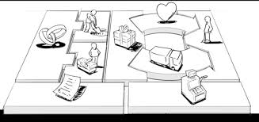
Evaluating Product/ Services Prototype
Session 26
Course : Software Engineering
Effective Period : Desember 2017

Slide 2
These slides have been adapted from
Osterwalder, Alexander et al. 2010. Business Model Generation: A Handbook for Visionaries, Game Changers, and Challengers. JWS. New Jersey. ISBN: 978-0470-87641-1.
Acknowledgement

Slide 3
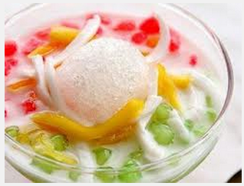

LO 4 : Analyze the software project management and the proposed potential business project
Learning Objectives
www.business-infrastructure.ch

Slide 4
Contents
Evaluating Business Model (Case)
Detailed SWOT Assessment of Each Business Block
Product/ Services Feasibility
Using SWOT Analysis Results to Design New Business Model Options

Slide 5

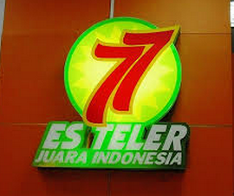
Evaluating Business Model (Case)
Es Teler is a type of cold drink that consists of fresh fruits – jackfruit, avocado and coconut, with a special syrup mix that makes the drink superbly enjoyable and delicious.
In 1981, a lady called Murniati Widjaja, won an Es Teler making competition in Jakarta. It was from this competition that an idea arose – to open a humble tent warung in a terrace of a shopping block (Duta Merlin, now Carrefour Harmoni) in central Jakarta.

Slide 6
Evaluating Business Model (Case)
This humble warung called Es Teler 77 is a family business, managed directly by Murniati herself, together with her husband, Trisno Budijanto, and their daughter and son-in-law, Yenny Setia Widjaja and Sukyatno Nugroho.

Slide 7

Evaluating Business Model (Case)
In 1987, Sukyatno Nugroho franschised Es Teler 77, and with it establishing itself as the first genuine Indonesian fast food that applied a franchising system.
Following the lifestyle trend, in 1994, all Es Teler 77 counters were moved from the kiosks to shopping malls and plazas. Es Teler 77’s presence in the modern shopping area broadens the Indonesian culinary horizon, with Es Teler 77 introducing the concept of fast food that provides Indonesian popular food and drinks.

Slide 8

Evaluating Business Model (Case)
After almost 3 decades, Es Teler 77 continues to grow by serving high quality food and drink products with original recipe to customers all around Indonesia and abroad.
With its 180 counters in different parts of Indonesia, Es Teler 77 not only improves the image of Indonesian culinary inside the country, but introduces Indonesian delicacy to other countries as well. Currently, Es Teler 77 is present in Singapore, Malaysia and Melbourne (Australia).

Slide 9
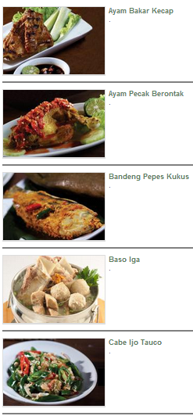
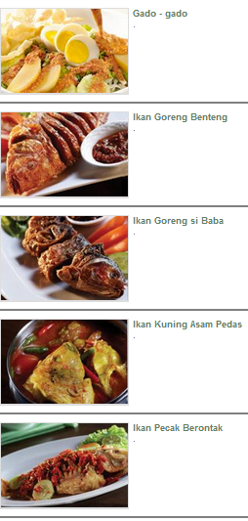
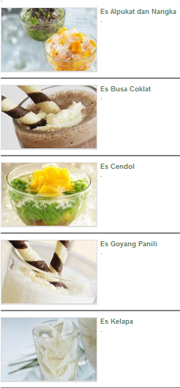
New Value Proposition: Product Differentiation
Es Teler 77

Slide 10
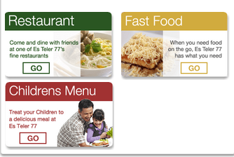
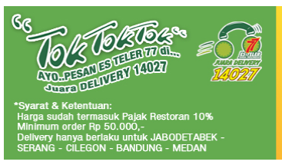
New Channel and Customer Segment
Es Teler 77

Slide 11
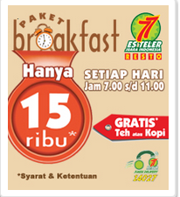

New Channel and Customer Segment
Es Teler 77

Slide 12
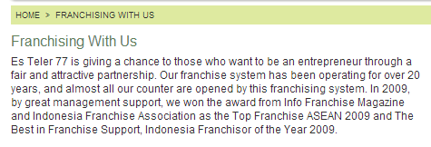

Key Partnership
(From family business to franchising)
Es Teler 77

Slide 13

Detailed SWOT Assessment of Each Business Block
SWOT analysis has four big questions:
The first two:
What are your organization Strength and Weakness – Assess your organization Internally
The second two:
What Opportunities does your organization have and what potential Threat does it face?

Slide 14
Detailed SWOT Assessment of Each Business Block
Two look as helpful area:
Strength and Opportunities
Two look as harmful area:
Weakness and Threat
These four questions are useful to assess overall business model and each of nine building blocks

Slide 15
Product/ Services
Feasibility Assessment
Customers perceive a need for product/ service | Customers are totally clueless about my products /services | 2.Customers must be educated about my products/ services before they see a need for it | 3.Customers must be convinced to buy from me instead of my competitors | 4.Customers need my products/ services and will often select them over competitors | 5.My customers need my products/ services and want to buy from me

Slide 16
Product/ Services
Feasibility Assessment
Product/ service is ready to sell | 1. I have not started developing my product/ service | 2. I Could have problems; I’m still developing products/ services | 3. I have sold some products/ services, but they are not completely tested or trouble free | 4. I have thoroughly tested my products/ services and am fixing the problems | 5. It’s all figured out! My products/ services work well with minimal problems

Slide 17
Product/ Services
Feasibility Assessment
Product/ service has unlimited life | Product/ services must be sold quickly so they don’t perish or become obsolete | 2. Product/ services have a relatively short life cycle which makes profits minimal | 3. I can make a profit before the life cycle ends for my products/ services | Products/ services have a fairly long life cycle which will allow for ample profits | Products/ services can be sold forever . The life cycle is unlimited

Slide 18
Product/ Services
Feasibility Assessment
Product/ service is unique and protectable | I just don’t have anything proprietary ; all I offer is similar to the competition | 2. Product/ service is not proprietary, but it stands out from the competition | 3. I’m going to do my best to create proprietary rights for my products/ services | My product is somewhat unique in function or style and can be legally protected | My products are unique in function and style can be legally protected

Slide 19
Product/ Services
Feasibility
Product/ Services is not regulated by the government | Complying with regulations is going to require lots of time and money | The regulations are undergoing change, possibly requiring more time and expense | The regulations are reasonable, but I’ll have to watch them closely. | It’s easy to comply with regulations for my specific products/ services. | Regulations are limited to those imposed on all businesses

Slide 20
Product/ Services
Feasibility
Product/ Service line has expansion potential | My product / service has no expansion potential | Right now, I only have one product/ service to sell | Definite expansion potential. Will require hard work to make it happen | I have the beginnings of a product/ service line with several things to sell | My products/ services complement each other, and I can easily add more to sell

Slide 21
Product/ Services
Feasibility
Product/ Service has no liability risk | I’m worried; I may encounter a large legal risk selling my products/ services | I’m not sure what the risks are in selling my products/ services | I can afford to protect myself for the risk involved in selling my products/ services | I will have minimal risk selling my products/ services; I can afford to protect my self | I’ll have no liability risk selling my products/ services

Slide 22
Product/ Services
Feasibility
Critical Success Factor:
Best Practice project Management
Ability and willingness to rapidly adapt the business model
Align “old” and “new” business model

Slide 23
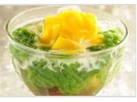
Using SWOT Analysis Results to Design New Business Model Options
A structured SWOT assessment of your product/ services prototype as part of your business model value proposition yields two results:
Provide snapshot where your product/ service prototype now (Strength and Weakness)
Suggest future trajectories (Opportunities and Threats)

Slide 24
References
Osterwalder, Alexander et al. 2010. Business Model Generation: A Handbook for Visionaries, Game Changers, and Challengers. JWS. New Jersey. ISBN: 978-0470-87641-1.
http://www.esteler77.com/

Slide 25
Q & A

